Slide 1
Cloud Computing
Cloud Technology

Slide 2
Technologies are covered
Broadband Networks and Internet Architecture
Data Center Technology
Virtualization Technology
Web Technology
Multitenant Technology
Service Technology

Slide 3
5.1 Broadband Networks and Internet Architecture
Internet Service Providers (ISPs)
Connectionless Packet Switching (Datagram Networks)
Router-Based Interconnectivity
Physical Network
Transport Layer Protocol
Application Layer Protocol
Technical and Business Considerations
Connectivity Issues
Network Bandwidth and Latency Issues
Cloud Carrier and Cloud Provider Selection

Slide 4
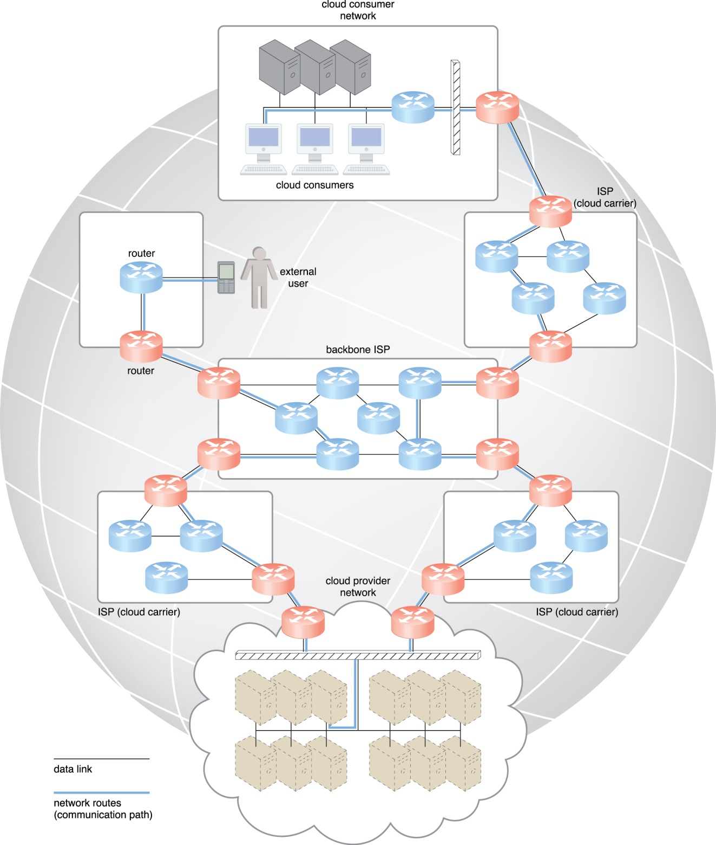
Figure 5.1 Messages travel over dynamic network routes in this ISP internetworking configuration.

Slide 5
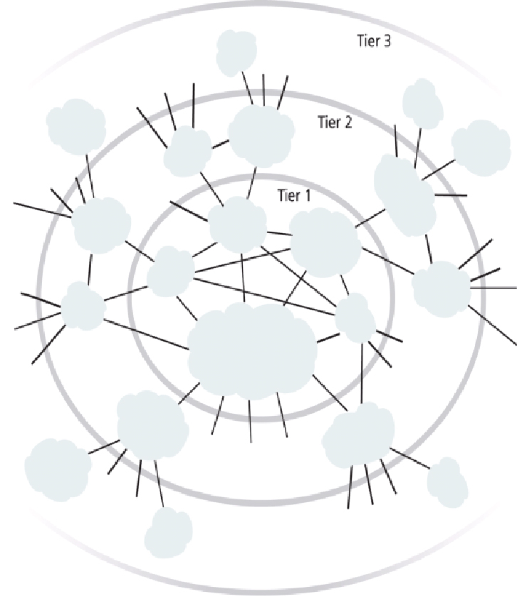
Figure 5.2 An abstraction of the internetworking structure of the Internet.

Slide 6
Connectionless Packet Switching
End-to-end (sender-receiver pair) data flows are divided into packets of a limited size that are received and processed through network switches and routers, then queued and forwarded from one intermediary node to the next.
Datagram Networks

Slide 7
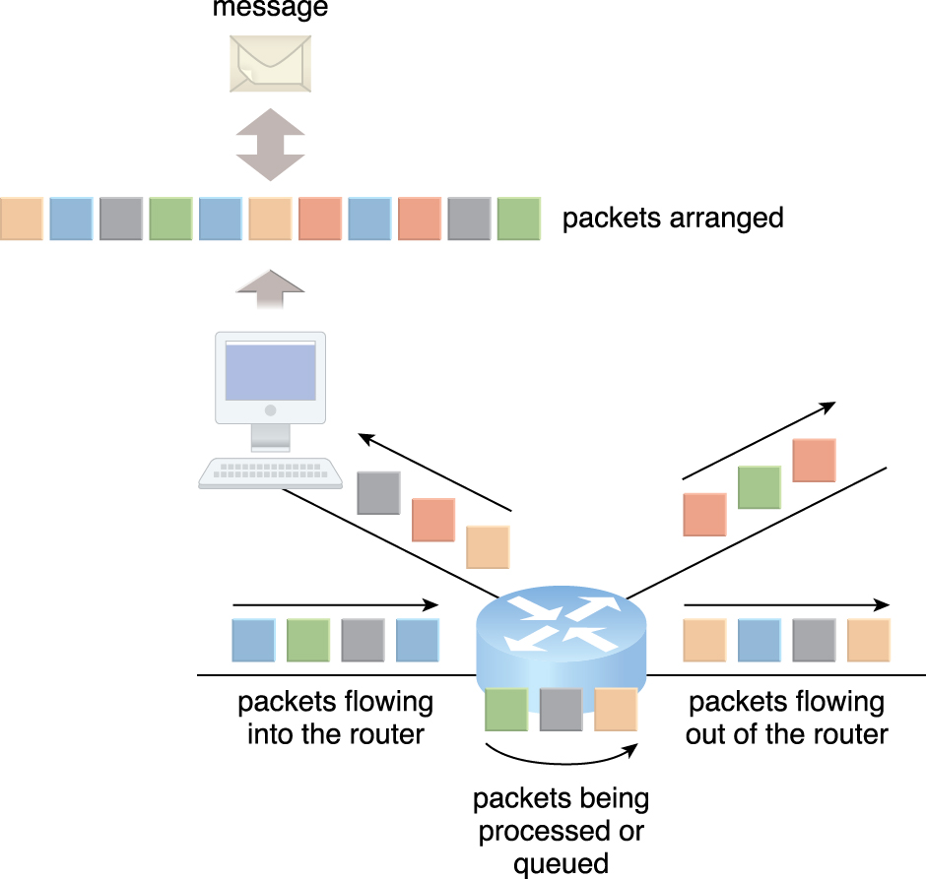
Router-Based Interconnectivity
Figure 5.3 Packets traveling through the Internet are directed by a router that arranges them into a message.

Slide 8
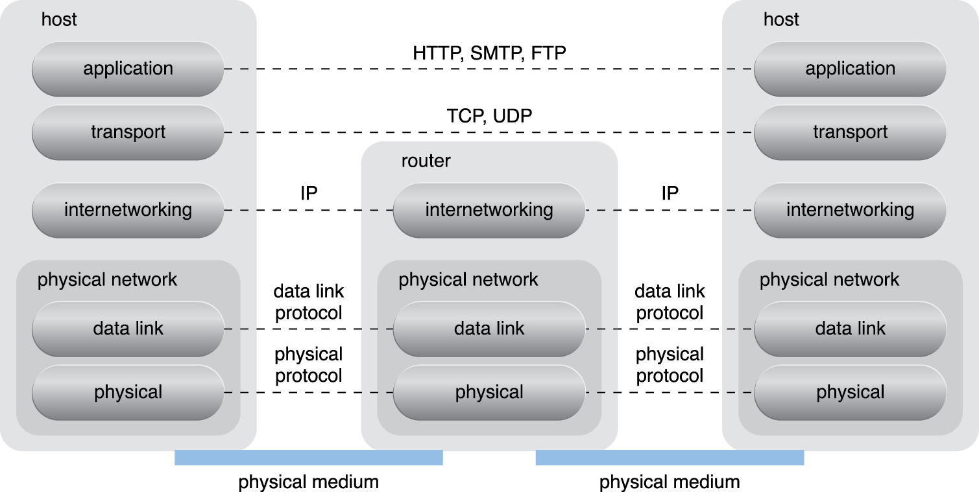
What are example for Phy/Tran/App layers?
Figure 5.3 Packets traveling through the Internet are directed by a router that arranges them into a message.

Slide 9
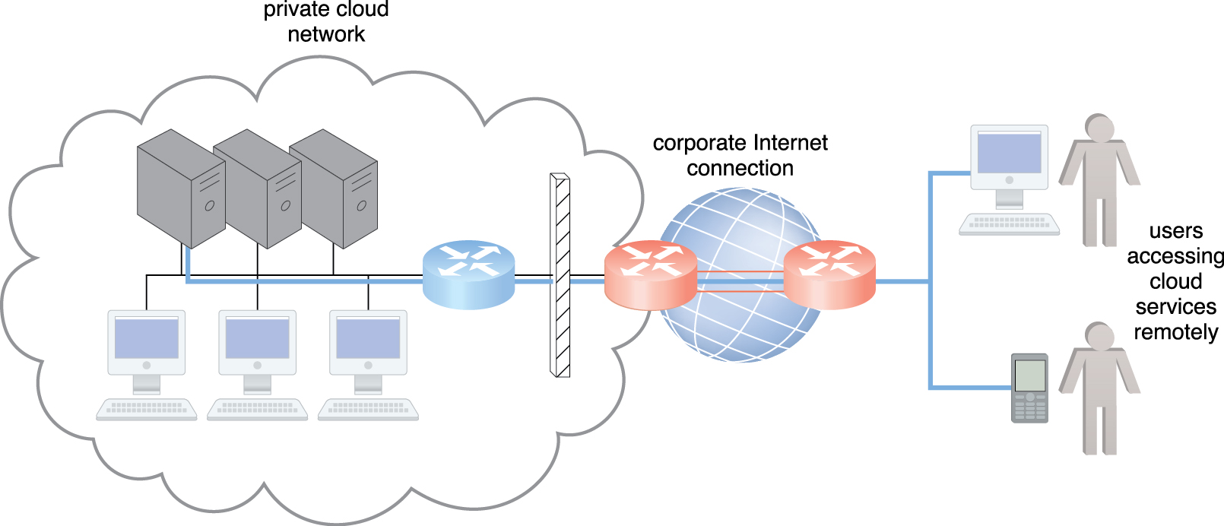
Technical and Business Considerations
Connectivity Issues
Figure 5.5 The internetworking architecture of a private cloud. The physical IT resources that constitute the
cloud are located and managed within the organization.

Slide 10
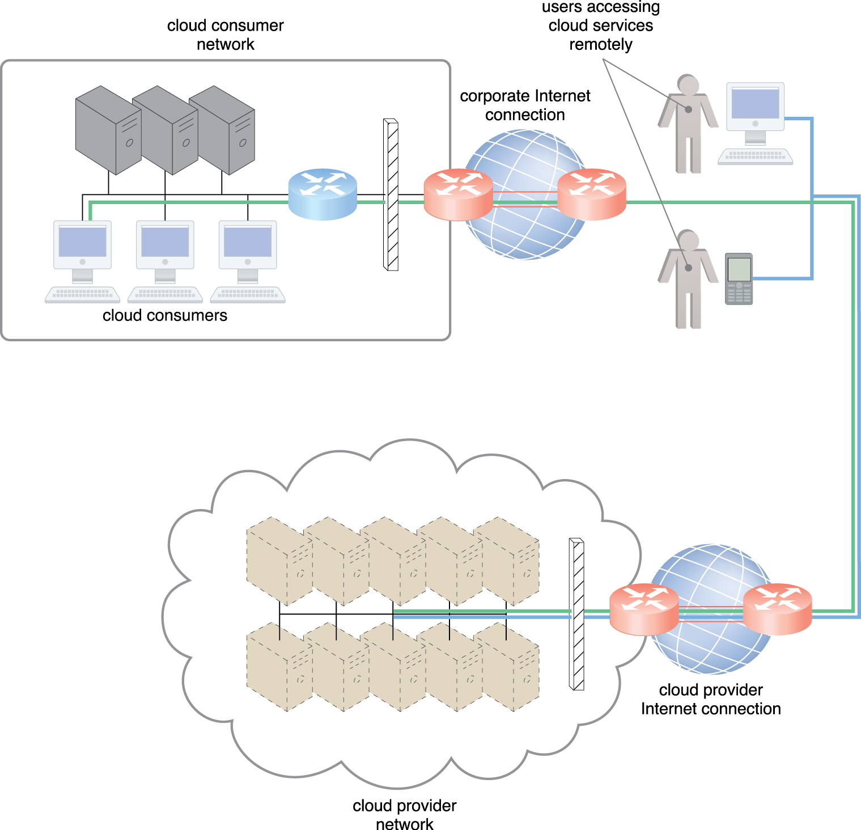
Connectivity Issues
Figure 5.6 The internetworking architecture of an Internet-based cloud deployment model. The Internet is the connecting agent between non-proximate cloud consumers, roaming end-users, and the cloud provider’s own network.

Slide 11
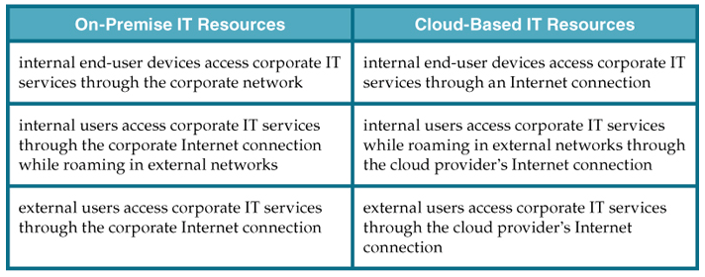
A comparison of on-premise and cloud-based internetworking

Slide 12
Technical and Business Considerations (cont..)
Network Bandwidth and Latency Issues
latency is the amount of time it takes a packet to travel from one data node to another.
Cloud Carrier and Cloud Provider Selection
QoS management across multiple ISPs is difficult to achieve in practice, requiring collaboration of the cloud carriers on both sides to ensure that their end-to-end service levels are sufficient for business requirements.

Slide 13
5.2. Data Center Technology
Data centers exist as specialized IT infrastructure used to house centralized IT resources, such as servers, databases, networking and telecommunication devices, and software systems.
Data centers are typically comprised of the following technologies and components:
Virtualization
Standardization and Modularity
Automation
Remote Operation and Management
High Availability
Security-Aware Design, Operation, and Management
Facilities
Computing Hardware
Storage Hardware
Network Hardware
Other considerations

Slide 14
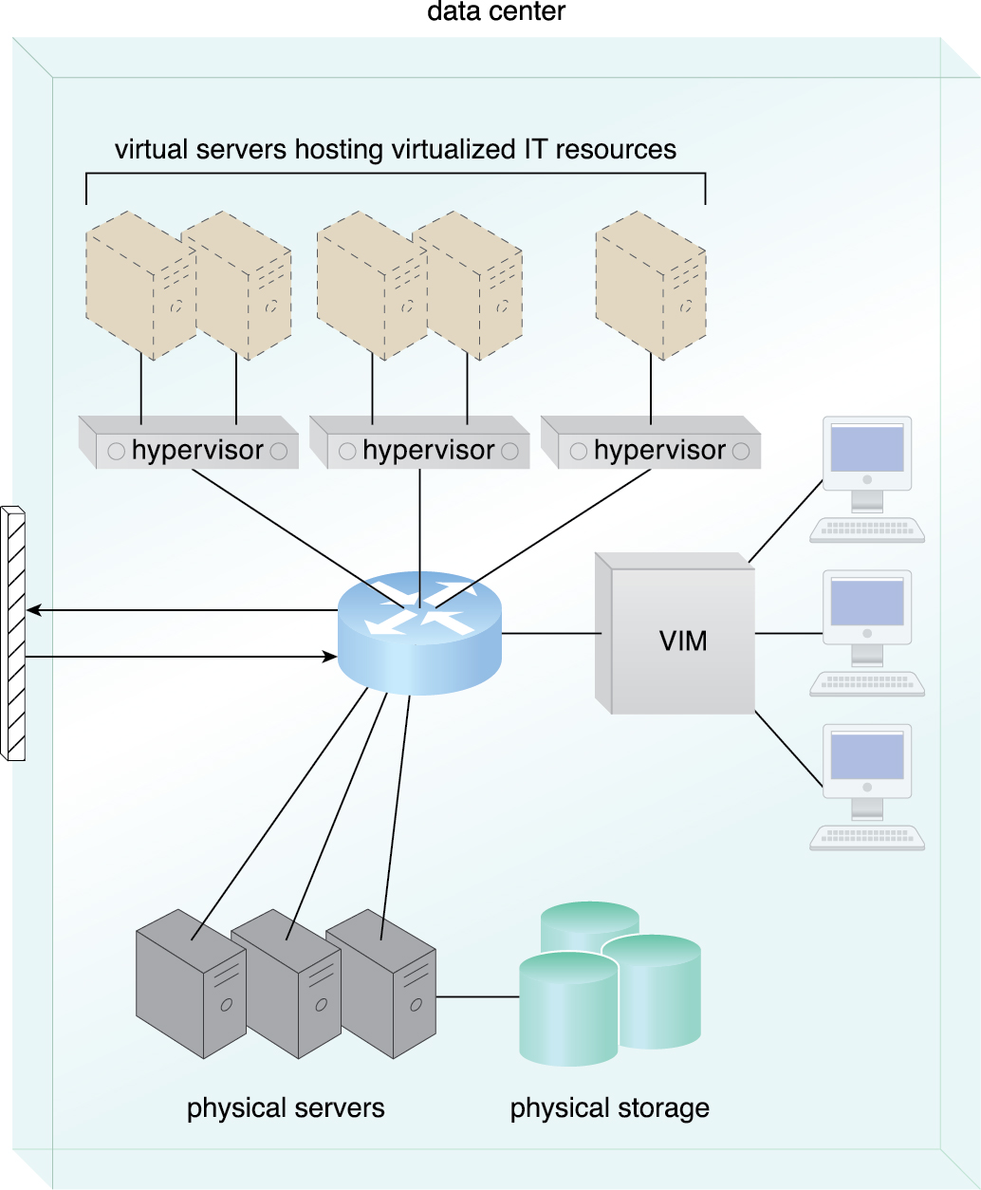
Virtualization
Data centers consist of both physical and virtualized IT resources.
Virtualized components that are easier to allocate, operate, release, monitor, and control.
Figure 5.7 The common components of a data center working together to provide virtualized IT resources
supported by physical IT resources.

Slide 15
Standardization and Modularity
Modularity and standardization are key requirements for reducing investment and operational costs as they enable economies of scale for the procurement, acquisition, deployment, operation, and maintenance processes.
Consolidated IT resources can serve different systems and be shared among different cloud consumers.

Slide 16
Automation
Data centers have specialized platforms that automate tasks like provisioning, configuration, patching, and monitoring without supervision.
Advances in data center management platforms and tools leverage autonomic computing technologies to enable self-configuration and self-recovery.

Slide 17
Remote Operation and Management
Most of the operational and administrative tasks of IT resources in data centers are commanded through the network’s remote consoles and management systems.
Technical personnel are not required to visit the dedicated rooms that house servers, except to perform highly specific tasks, such as equipment handling and cabling or hardware-level installation and maintenance.

Slide 18
High Availability
Data center outage significantly impacts business continuity for the organizations that use their services, data centers are designed to operate with increasingly higher levels of redundancy to sustain availability.
Data centers usually have redundant, uninterruptable power supplies, cabling, and environmental control subsystems in anticipation of system failure, along with communication links and clustered hardware for load balancing.

Slide 19
Security-Aware Design, Operation, and Management
Physical and logical access controls and data recovery strategies, need to be thorough and comprehensive for data centers, since they are centralized structures that store and process business data.
Outsourcing data center-based IT resources has been a common industry practice for decades.
Outsourcing models often required long-term consumer commitment

Slide 20
Facilities
Data center facilities are custom-designed locations that are outfitted with specialized computing, storage, and network equipment.
Facilities have several functional layout areas, as well as various power supplies, cabling, and environmental control stations that regulate heating, ventilation, air conditioning, fire protection, and other related subsystems.

Slide 21
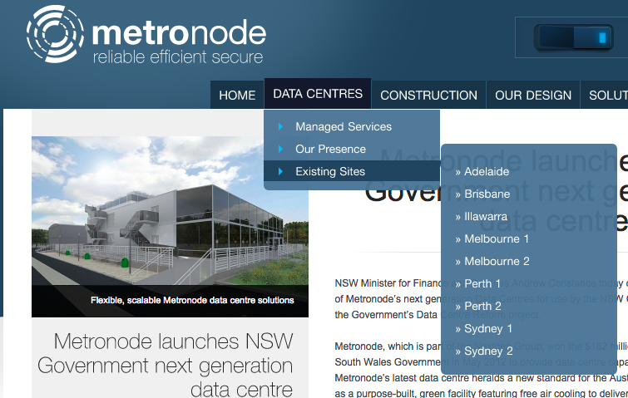
http://www.metronode.com.au/metronode-launches-nsw-government-next-generation-data-centre/

Slide 22
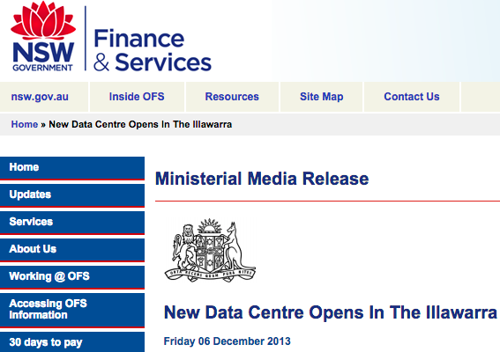
http://www.finance.nsw.gov.au/new-data-centre-opens-illawarra-0

Slide 23
Computing Hardware
Data centers is often executed by standardized commodity servers that have substantial computing power and storage capacity.
rackmount form factor server design composed of standardized racks with interconnects for power, network, and internal cooling
support for different hardware processing architectures, such as x86-32bits, x86-64, and RISC
a power-efficient multi-core CPU architecture that houses hundreds of processing cores in a space as small as a single unit of standardized racks
redundant and hot-swappable components, such as hard disks, power supplies, network interfaces, and storage controller cards

Slide 24
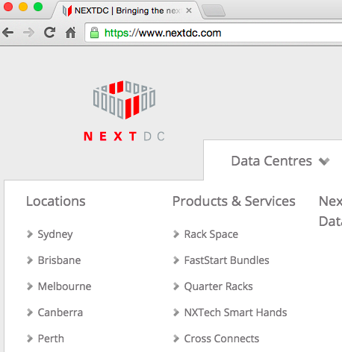
Storage Hardware
Data centers have specialized storage systems that maintain enormous amounts of digital information in order to fulfill considerable storage capacity needs.
Storage systems are containers housing numerous hard disks that are organized into arrays.

Slide 25
Network Hardware
Data centers require extensive network hardware in order to enable multiple levels of connectivity.
Data center is broken down into five network subsystems:
Carrier and External Networks Interconnection
Web-Tier Load Balancing and Acceleration
LAN Fabric
SAN Fabric
NAS Gateways

Slide 26
Other Considerations
IT hardware is subject to rapid technological obsolescence, with lifecycles that typically last between five to seven years.
Security is another major issue when considering the role of the data center and the vast quantities of data contained within its doors.

Slide 27
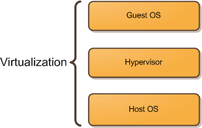
5.3. Virtualization Technology
Virtualization is the process of converting a physical IT resource into a virtual IT resource.
Most types of IT resources can be virtualized, including:
Servers – A physical server can be abstracted into a virtual server.
Storage – A physical storage device can be abstracted into a virtual storage device or a virtual disk.
Network – Physical routers and switches can be abstracted into logical network fabrics, such as VLANs.
Power – A physical UPS and power distribution units can be abstracted into what are commonly referred to as virtual UPSs.
Source: itechthoughts.wordpress.com

Slide 28
Hardware Independence
Virtualization is a conversion process that translates unique IT hardware into emulated and standardized software-based copies.
Virtual servers can easily be moved to another virtualization host, automatically resolving multiple hardware-software incompatibility issues.
Cloning and manipulating virtual IT resources is much easier than duplicating physical hardware.

Slide 29
Server Consolidation
The coordination function that is provided by the virtualization software allows multiple virtual servers to be simultaneously created in the same virtualization host.
Enables different virtual servers to share one physical server.
Is commonly used to increase hardware utilization, load balancing, and optimization of available IT resources.
Is fundamental capability directly supports common cloud features, such as on-demand usage, resource pooling, elasticity, scalability, and resiliency.

Slide 30
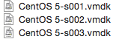
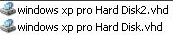
Resource Replication
Virtual servers are created as virtual disk images that contain binary file copies of hard disk content.
Virtual disk images are accessible to the host’s operating system, meaning simple file operations, such as copy, move, and paste, can be used to replicate, migrate, and back up the virtual server.

Slide 31
Operating System-Based Virtualization
Operating system-based virtualization is the installation of virtualization software in a pre-existing operating system, which is called the host operating system
Hardware independence that is enabled by virtualization allows hardware IT resources to be more flexibly used.
Virtualization software translates hardware IT resources that require unique software for operation into virtualized IT resources that are compatible with a range of operating systems.
System-based virtualization is the processing overhead required to run the virtualization software and host operating systems.
Estimating, monitoring, and managing the resulting impact can be challenging because it requires expertise in system workloads, software and hardware environments, and sophisticated monitoring tools.

Slide 32
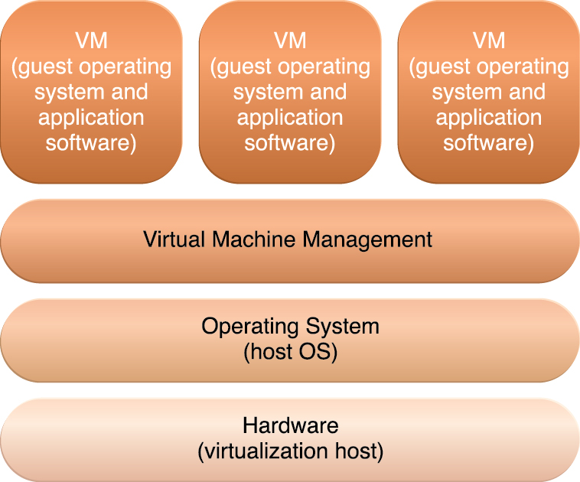
Hypervisor type?
Example products?
Figure 5.8 The different logical layers of operating system-based virtualization, in which the VM is first
installed into a full host operating system and subsequently used to generate virtual machines.

Slide 33
Hardware-Based Virtualization
Represents the installation of virtualization software directly on the physical host hardware so as to bypass the host operating system.
Allowing the virtual servers to interact with hardware without requiring intermediary action from the host operating system generally makes hardware-based virtualization more efficient.
Virtualization software is typically referred to as a hypervisor for this type of processing.
A hypervisor has a simple user-interface that requires a negligible amount of storage space.
Main issues of hardware-based virtualization concerns compatibility with hardware devices.

Slide 34
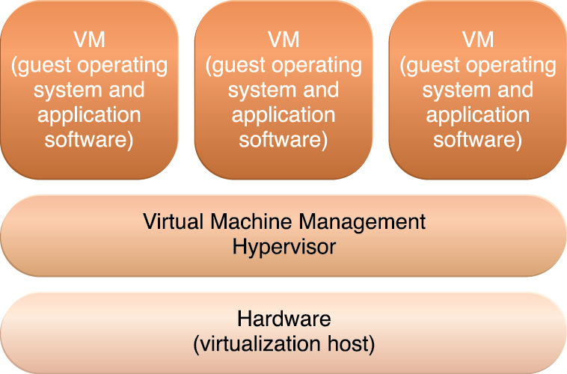
Hypervisor type?
Example products?
Figure 5.9 The different logical layers of hardware-based virtualization, which does not require another
host operating system.

Slide 35
Virtualization Management
Modern virtualization software provides several advanced management functions that can automate administration tasks and reduce the overall operational burden on virtualized IT resources.
Virtualized IT resource management is often supported by virtualization infrastructure management (VIM) tools that collectively manage virtual IT resources and rely on a centralized management module

Slide 36
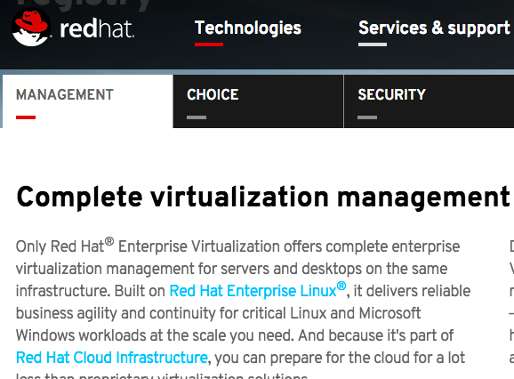
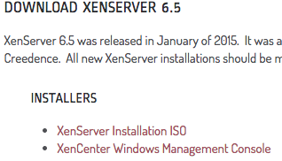
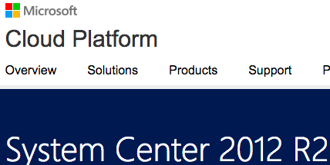
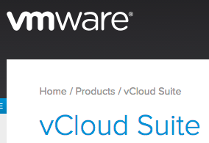

Slide 37
Other Considerations
Performance Overhead – Virtualization may not be ideal for complex systems that have high workloads with little use for resource sharing and replication.
Special Hardware Compatibility – Many hardware vendors that distribute specialized hardware may not have device driver versions that are compatible with virtualization software.
Portability – The programmatic and management interfaces that establish administration environments for a virtualization program to operate with various virtualization solutions can introduce portability gaps due to incompatibilities. Initiatives such as the Open Virtualization Format (OVF) for the standardization of virtual disk image formats are dedicated to alleviating this concern.
How to Convert VMware Virtual Machines to XenServer Virtual Machines
Convert-VHD
VMware Open Virtualization Format Tool 4.0

Slide 38
5.4. Web Technology
Cloud computing’s fundamental reliance on internetworking, Web browser universality, and the ease of Web-based service development.
Web technology is generally used as both the implementation medium and the management interface for cloud services.

Slide 39
Basic Web Technology
Uniform Resource Locator (URL) – A standard syntax used for creating identifiers that point to Web-based resources, the URL is often structured using a logical network location.
Hypertext Transfer Protocol (HTTP) – This is the primary communications protocol used to exchange content and data throughout the World Wide Web. URLs are typically transmitted via HTTP.
Markup Languages (HTML, XML) – Markup languages provide a lightweight means of expressing Web-centric data and metadata. The two primary markup languages:
HTML: which is used to express the presentation of Web pages
XML: which allows for the definition of vocabularies used to associate meaning to Web-based data via metadata.

Slide 40
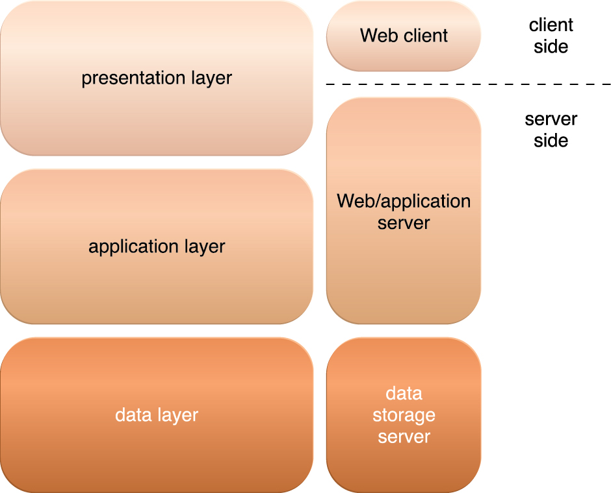
Web Applications
Figure 5.10 The three basic architectural tiers of Web applications.

Slide 41
5.5. Multitenant Technology
The multitenant application design was created to enable multiple users (tenants) to access the same application logic simultaneously.
Each tenant has its own view of the application that it uses, administers, and customizes as a dedicated instance of the software while remaining unaware of other tenants that are using the same application.
Multitenant applications ensure that tenants do not have access to data and configuration information that is not their own.
Tenants can individually customize features of the application, such as:
User Interface – Tenants can define a specialized “look and feel” for their application interface.
Business Process – Tenants can customize the rules, logic, and workflows of the business processes that are implemented in the application.
Data Model – Tenants can extend the data schema of the application to include, exclude, or rename fields in the application data structures.
Access Control – Tenants can independently control the access rights for users and groups.

Slide 42
5.5. Multitenant Technology (cont..)
Multitenant application architecture is often significantly more complex than that of single-tenant applications.
Common characteristics of multitenant applications include:
Usage Isolation – The usage behavior of one tenant does not affect the application availability and performance of other tenants.
Data Security – Tenants cannot access data that belongs to other tenants.
Recovery – Backup and restore procedures are separately executed for the data of each tenant.
Application Upgrades – Tenants are not negatively affected by the synchronous upgrading of shared software artifacts.
Scalability – The application can scale to accommodate increases in usage by existing tenants and/or increases in the number of tenants.
Metered Usage – Tenants are charged only for the application processing and features that are actually consumed.
Data Tier Isolation – Tenants can have individual databases, tables, and/or schemas isolated from other tenants.

Slide 43
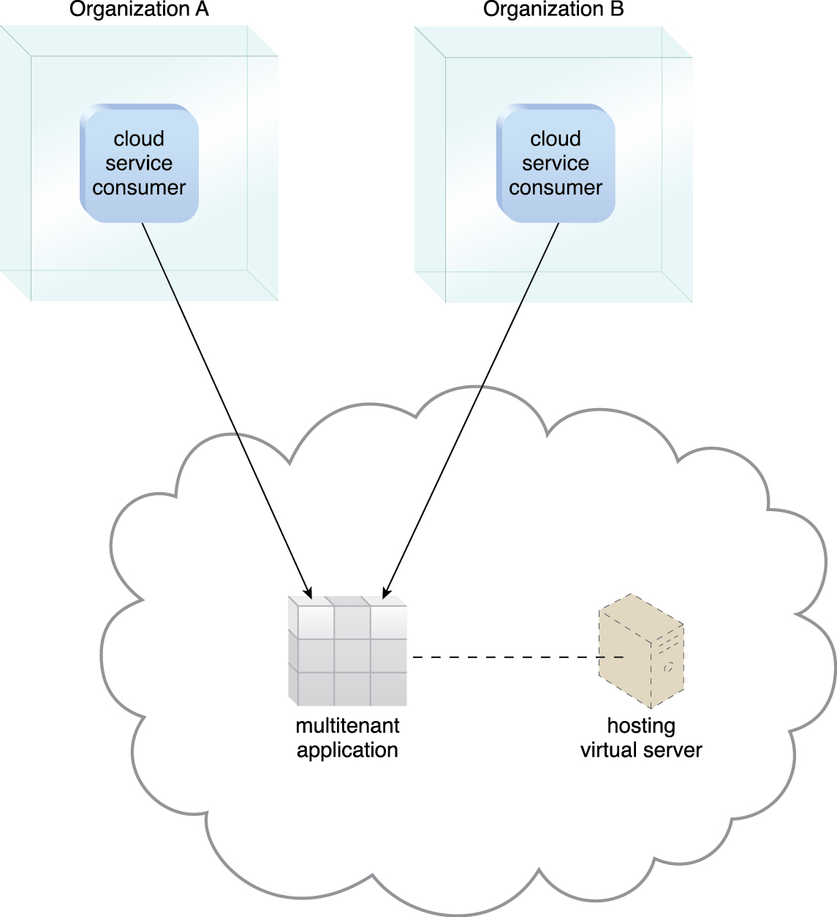
Figure 5.11 A multitenant application that is serving multiple cloud service consumers simultaneously.

Slide 44
Multitenancy vs. Virtualization
Multitenancy is sometimes mistaken for virtualization because the concept of multiple tenants is similar to the concept of virtualized instances.
The differences lie in what is multiplied within a physical server acting as a host:
With virtualization: Multiple virtual copies of the server environment can be hosted by a single physical server. Each copy can be provided to different users, can be configured independently, and can contain its own operating systems and applications.
With multitenancy: A physical or virtual server hosting an application is designed to allow usage by multiple different users. Each user feels as though they have exclusive usage of the application.

Slide 45
5.6. Service Technology
Service technology is a keystone foundation of cloud computing that formed the basis of the “as-a-service” cloud delivery models.
Web Services
Web Service Description Language (WSDL) – This markup language is used to create a WSDL definition that defines the application programming interface (API) of a Web service.
XML Schema Definition Language (XML Schema) – Messages exchanged by Web services must be expressed using XML.
SOAP – Formerly known as the Simple Object Access Protocol, this standard defines a common messaging format used for request and response messages exchanged by Web services.
Universal Description, Discovery, and Integration (UDDI) – This standard regulates service registries in which WSDL definitions can be published as part of a service catalog for discovery purposes.

Slide 46
REST Services
REST services are designed according to a set of constraints that shape the service architecture to emulate the properties of the World Wide Web.
REST services do not have individual technical interfaces but instead share a common technical interface that is known as the uniform contract, which is typically established via the use of HTTP methods.
The six REST design constraints are:
Client-Server
Stateless
Cache
Interface/Uniform Contract
Layered System
Code-On-Demand

Slide 47
Service Agents
Service agents are event-driven programs designed to intercept messages at runtime.
There are active and passive service agents.
Active service agents perform an action upon intercepting and reading the contents of a message.
Passive service agents, on the other hand, do not change message contents..
Cloud-based environments rely heavily on the use of system-level and custom service agents to perform much of the runtime monitoring and measuring required to ensure that features, such as elastic scaling and pay-for-use billing, can be carried out instantaneously.

Slide 48
Service Middleware
Middleware platforms that evolved from messaging-oriented middleware (MOM) platforms used primarily to facilitate integration, to sophisticated service middleware platforms designed to accommodate complex service compositions.
Two most common types of middleware platforms relevant to services computing are
Enterprise service bus (ESB): encompasses a range of intermediary processing features, including service brokerage, routing, and message queuing.
Orchestration platform: environments are designed to host and execute workflow logic that drives the runtime composition of services.

Slide 49
Summary
Cloud consumers and cloud providers typically use the Internet to communicate, which is based on a decentralized provisioning and management model and is not controlled by any centralized entities.
The main components of internetworking architecture are connectionless packet switching and router-based interconnectivity, which use network routers and switches.
Network bandwidth and latency are characteristics that influence QoS, which is heavily impacted by network congestion.
A data center is a specialized IT infrastructure that houses centralized IT resources, such as servers, databases, and software systems.
Data center IT hardware is typically comprised of standardized commodity servers of increased computing power and storage capacity, while storage system technologies include disk arrays and storage virtualization.
Technologies used to increase storage capacity include DAS, SAN, and NAS.

Slide 50
Summary (cont..)
Computing hardware technologies include rackmounted server arrays and multi-core CPU architectures, while specialized high-capacity network hardware and technology, such as content-aware routing, LAN and SAN fabrics, and NAS gateways, are used to improve network connectivity.
Server virtualization is the process of abstracting IT hardware into virtual servers using virtualization software.
Virtualization provides hardware independence, server consolidation, and resource replication, and further supports resource pooling and elastic scalability.
Virtual servers are realized through either operating system-based or hardware-based virtualization.
Web technology is very commonly used for cloud service implementations and for front-ends used to remotely manage cloud-based IT resources.
Fundamental technologies of Web architecture include the URL, HTTP, HTML, and XML.

Slide 51
Summary (cont..)
Web-based services, such as Web services and REST services, rely on non-proprietary communications and technical interface definitions to establish standardized communications frameworks based on Web technology.
Service agents provide event-driven runtime processing that can be applied to numerous functional areas within clouds. Many are deployed automatically as part of operating systems and cloud-based products.
Service middleware, such as ESBs and orchestration platforms, can be deployed on clouds.

